Slide 1
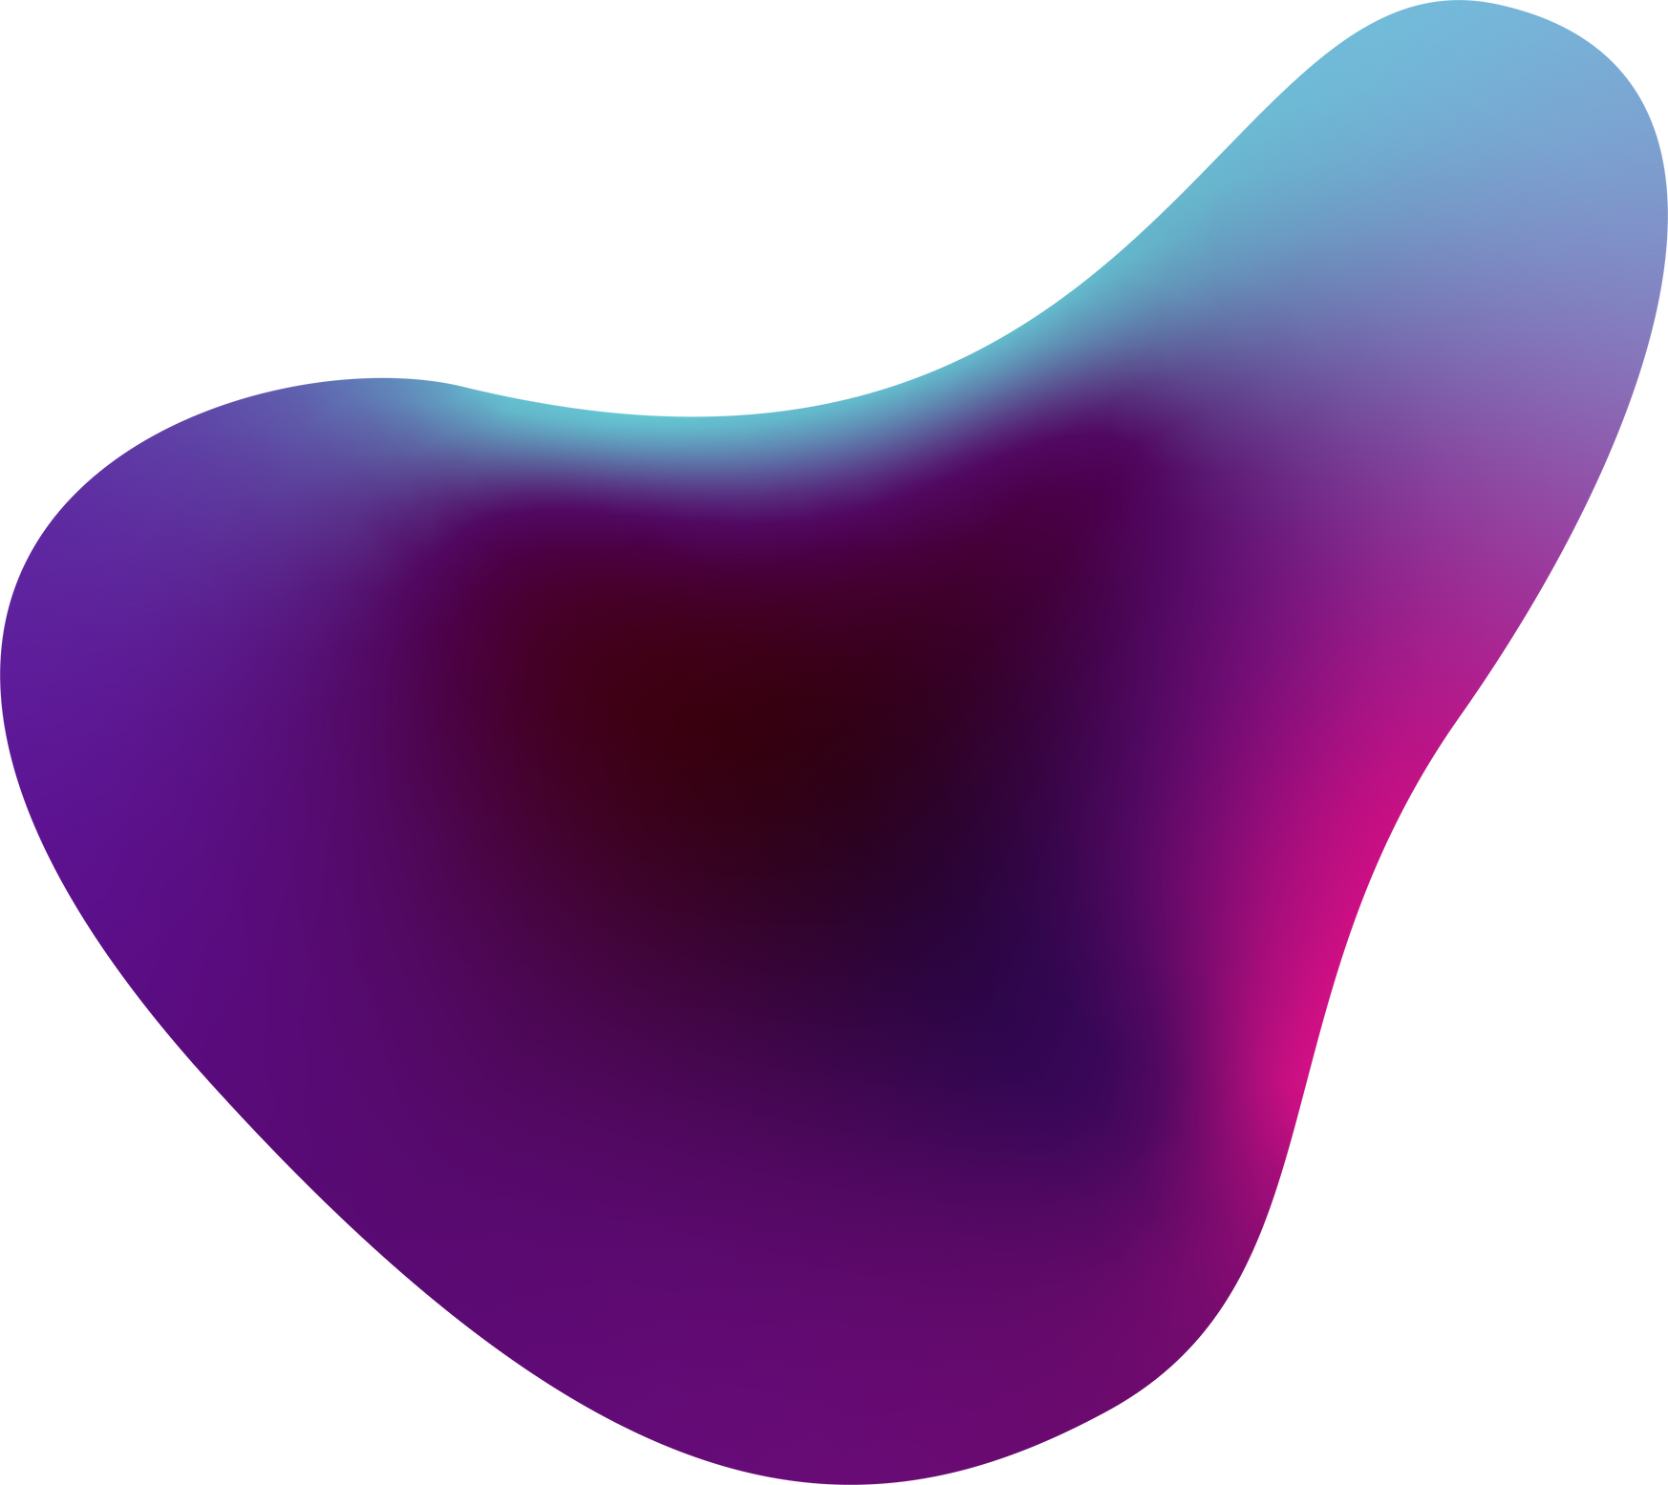

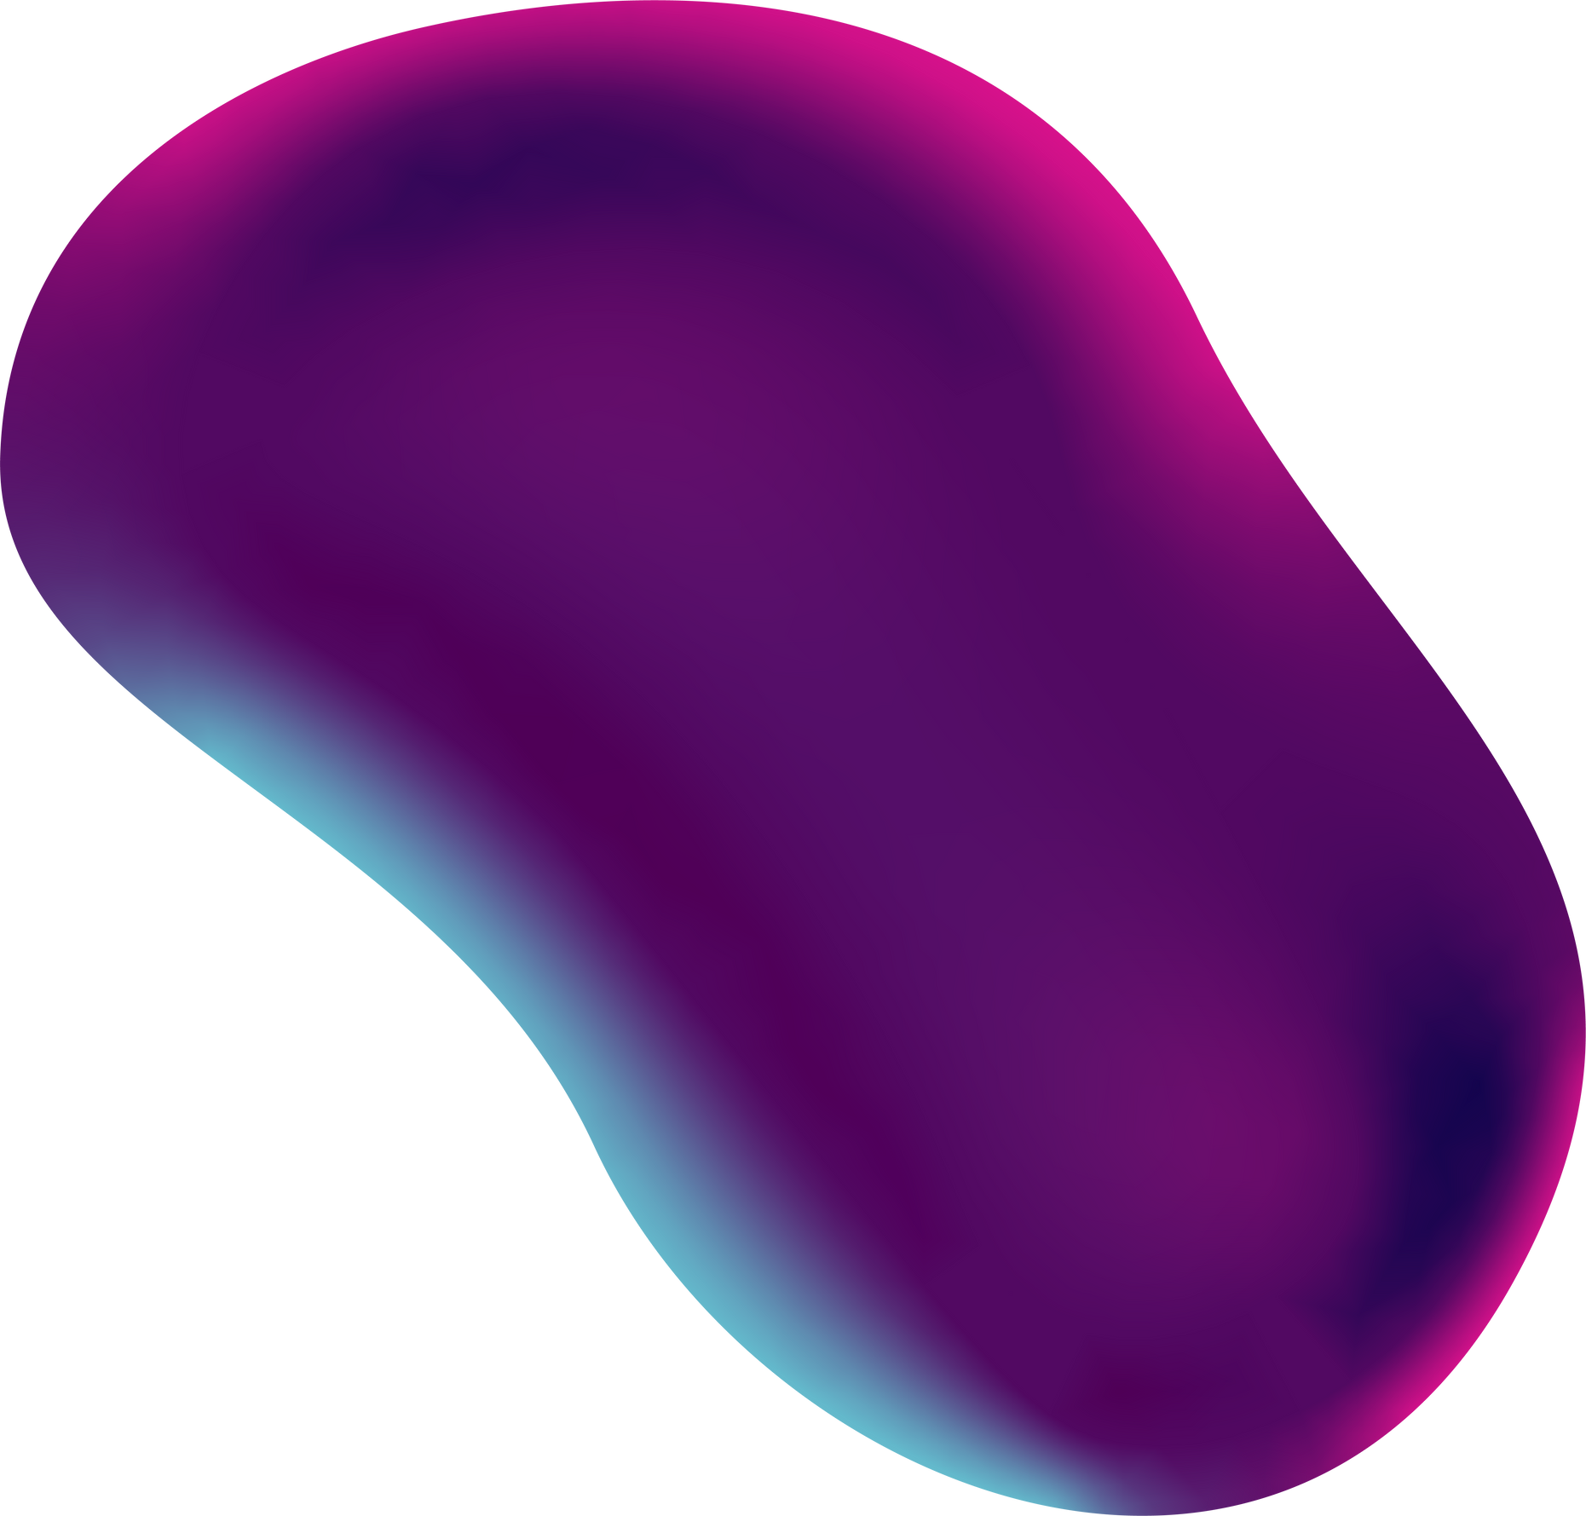
Stroke Prediction
Faridat Lawal
BUSI 650
Professor Sheikh
NYIT
Fall 2022

Slide 2
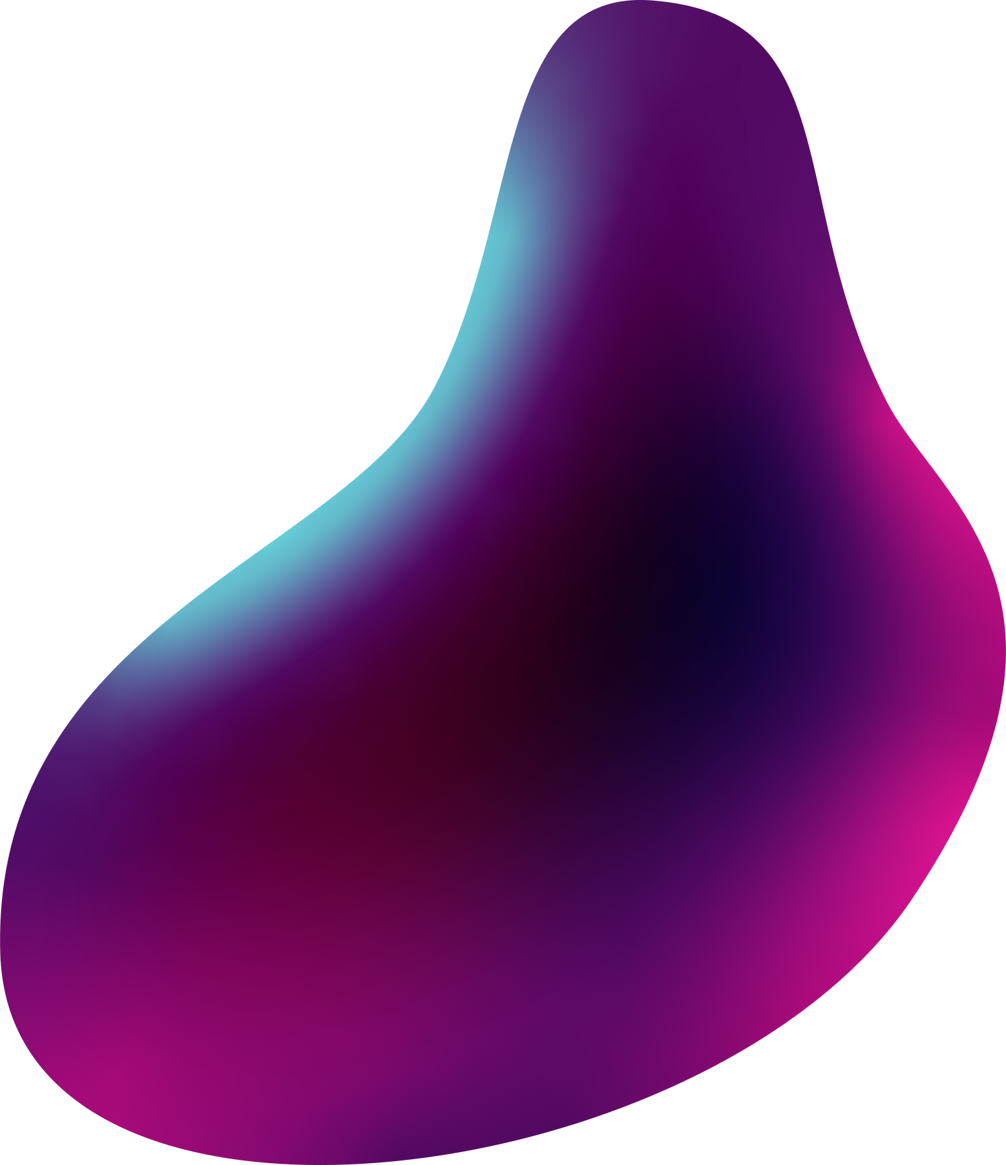

Objective
The objective/goal of this project is to predict whether a patient is likely to have a stroke based on input features with the use of supervised learning models. Data mining tasks will include cleaning the provided dataset and preparing it for various model evaluations such as Naive Bayes, K-NN, Decision Tree, and Random Forest.

Slide 3
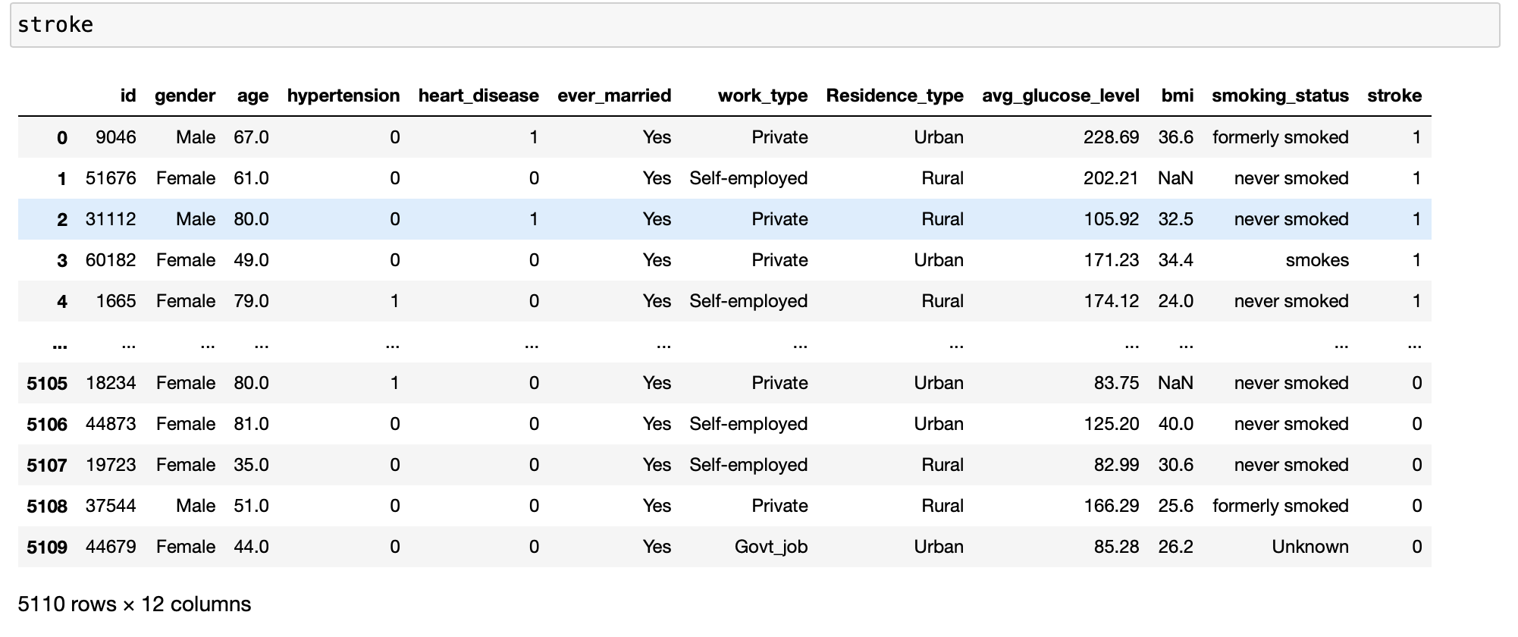
Data Set
The Stroke prediction dataset was found on Kaggle. It contains 5110 rows and 12 columns. Based off of the snapshot provided it can be seen that we have 8 categorical variables and 4 numerical attributes.

Slide 4
Data Preprocessing

Slide 5
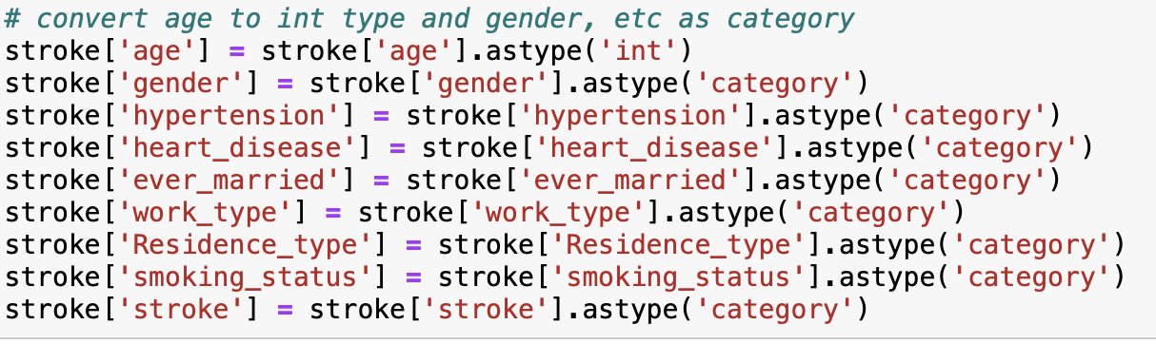
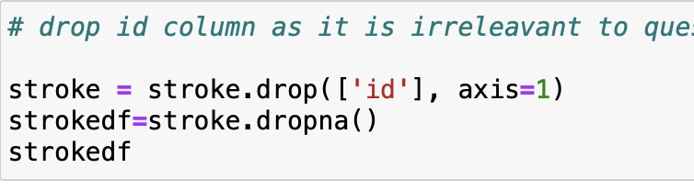
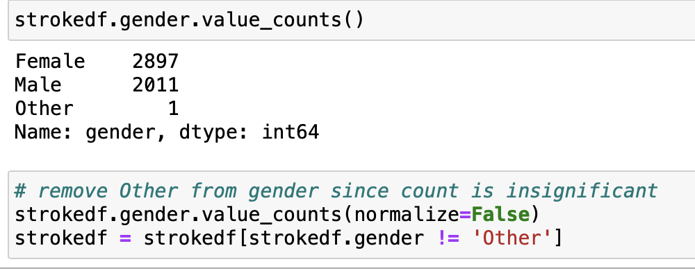
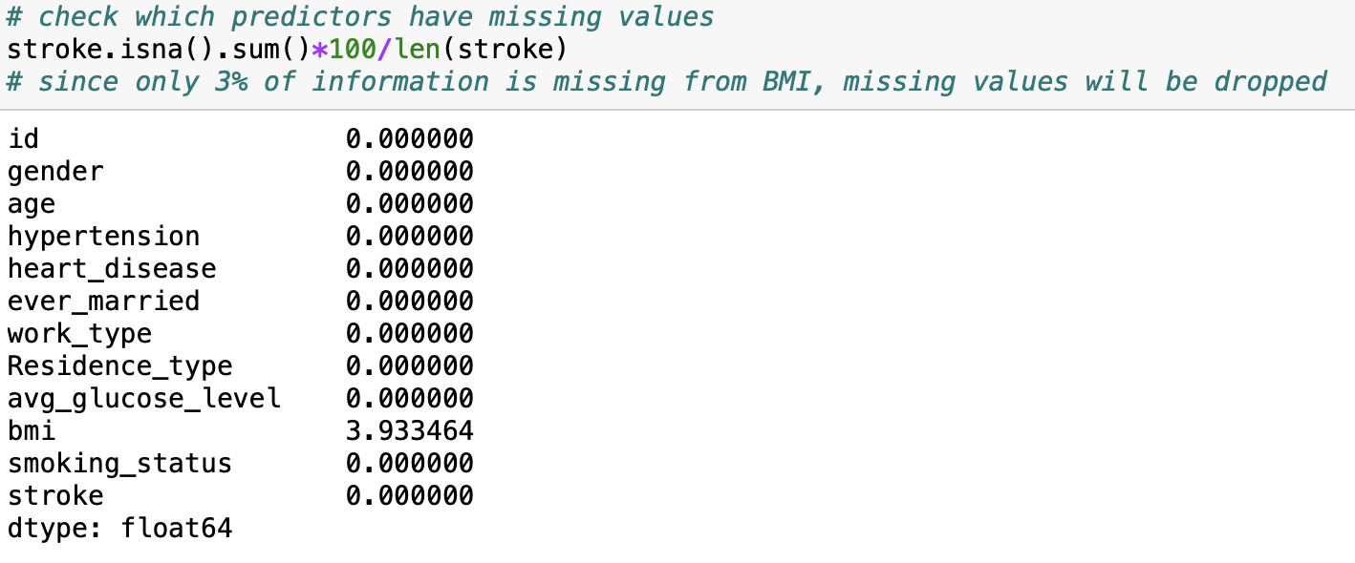
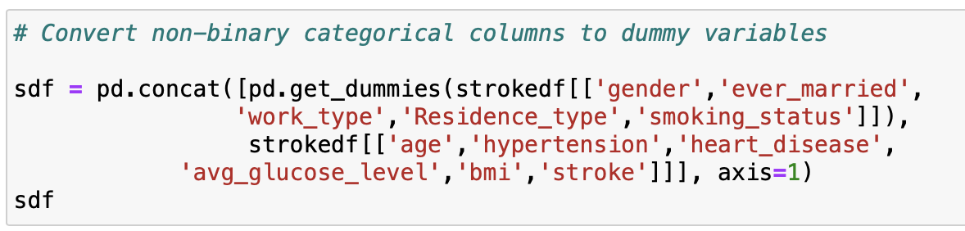
Before model evaluations can begin, there are a few things needed in order to prepare the dataset.
Type of attributes were properly assigned for categorical and numerical features
Irrelevant columns/rows that would have no impact on predictions were removed
Missing values were dropped as long as they did not remove a large chunk of data
Dummy variables were created for non-binary categorical features

Slide 6
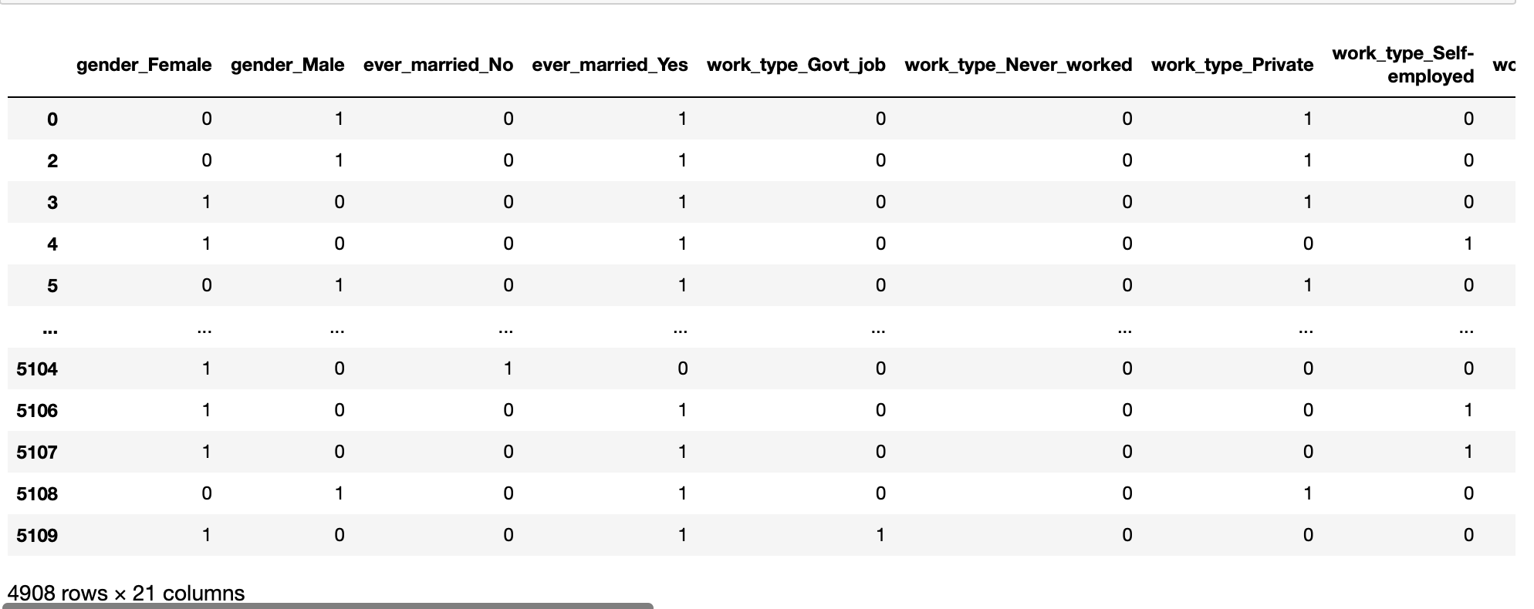
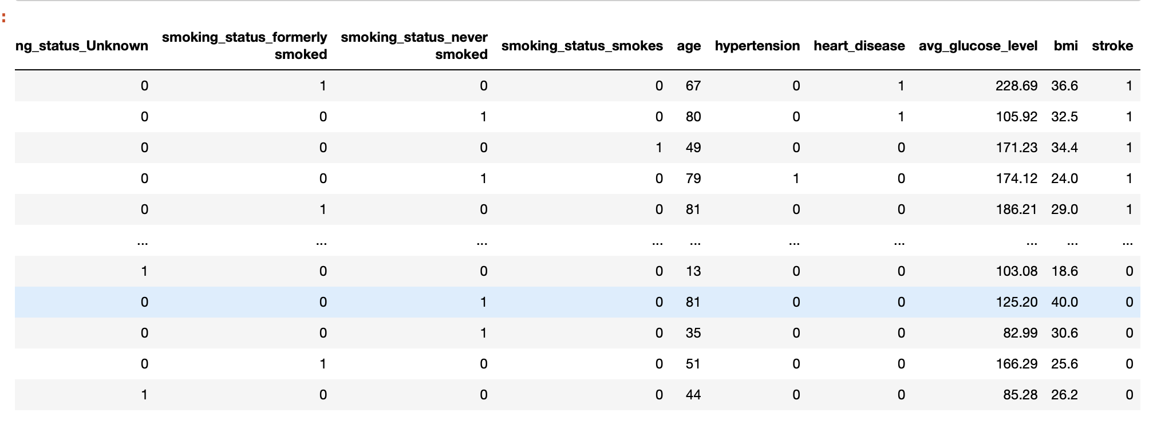
After preprocessing, the shape of the final dataset is 4908 rows and 21 columns.
What's in
store for us?
Future of Technology
Next generation holographic communication will soon change the way we work and conduct meetings in the workplace, significantly unifying geographically dispersed employees.
With 3D holographic avatars and images, offices can significantly reduce the cost of transporting employees in one place, minimizing airspace travel hazards on the environment.

Slide 7
Exploratory Data Analysis
Correlation Graphs and Histograms to explore and visualize the relationships between the features.

Slide 8
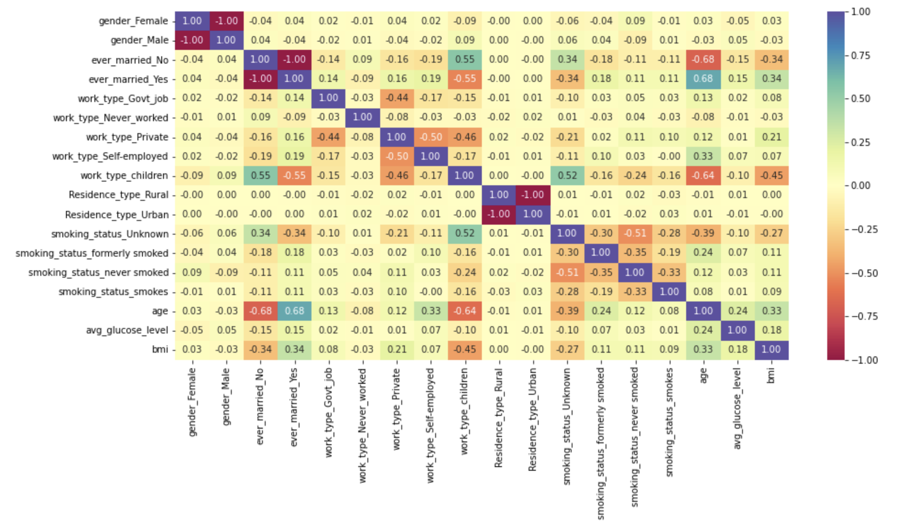
Correlation Map
Small positive correlation between Age and WorkType, Smoking Status, Avg Glucose Level, BMI
Medium positive correlation between Age and Marital Status (yes)
Medium Negative correlation between Age and Marital Status (no)
Here are some predictions
What's in
store for us?
It's time we see and engage with the world differently. Right now, we experience augmented reality through games, but there's a lot to it more than entertainment.
Real use cases of augmented reality include medical training, classroom education, business logistics, and the tourism industry.

Slide 9
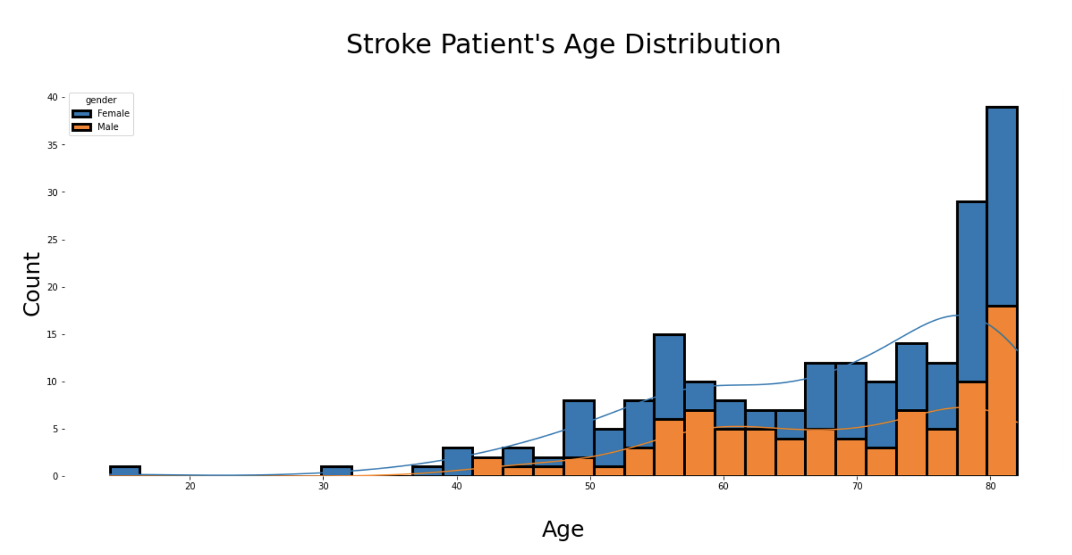
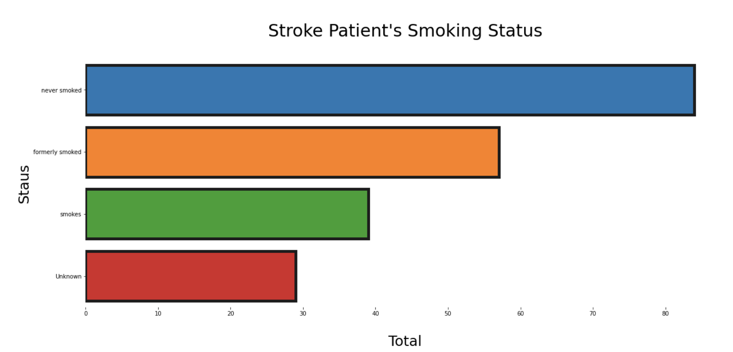
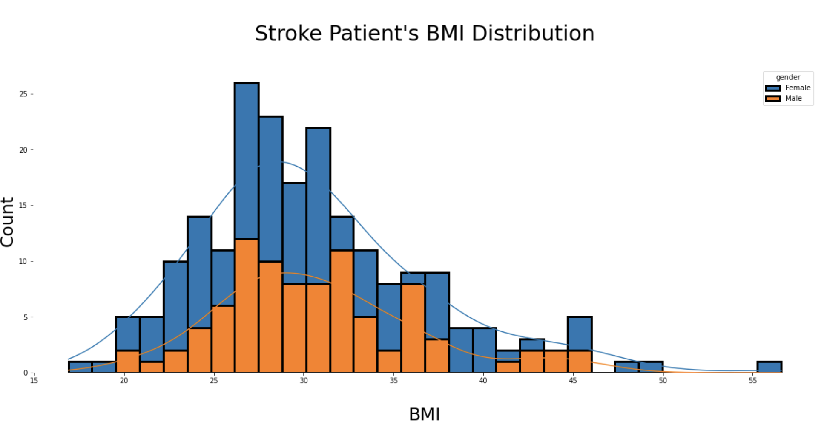
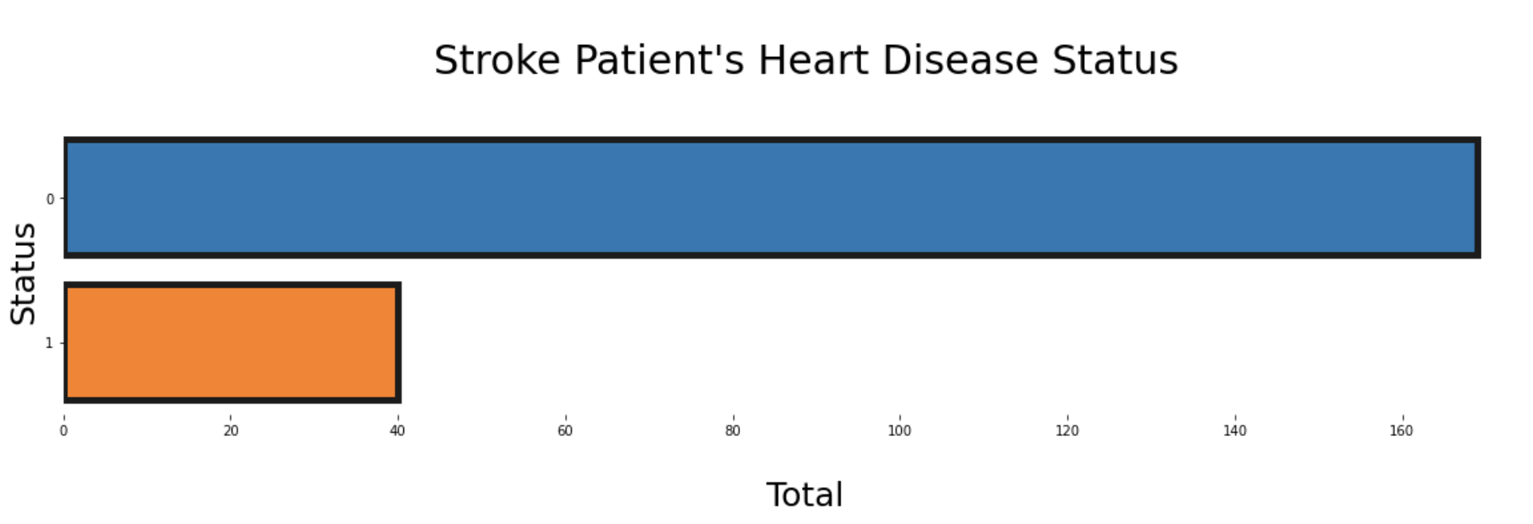
Histograms & Plots
For Age distribution, most of the patients fall between 60 to about ~85 years old.
Most of the Stroke patients have Never smoked while some have smoked previously.
For BMI distribution, most of the patients fall between 25 to 35.
Majority of the stroke patients do not have heart disease.

Slide 10
Model Evaluation
Dataset is split into Training and Testing sets to evaluate its accuracy and prediction measures as well.

Slide 11

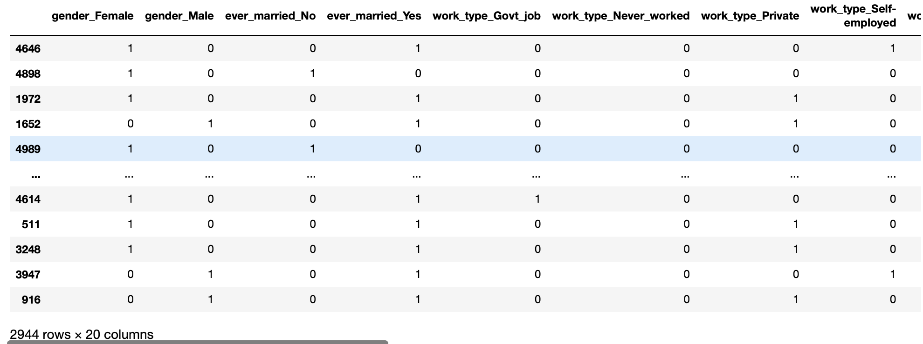
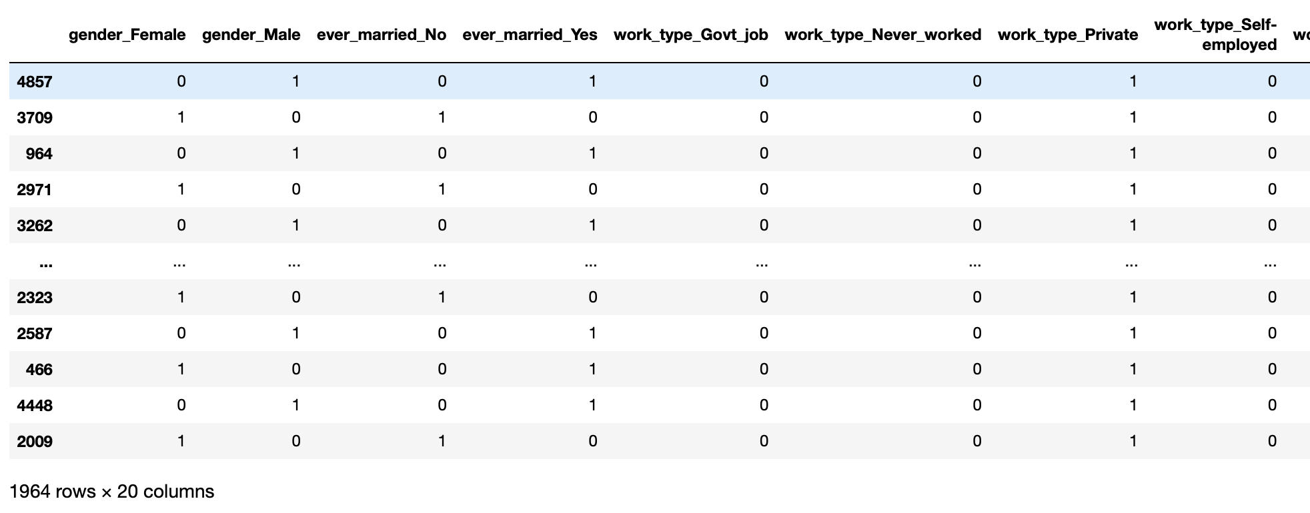
X_train
In the future
X_test

Slide 12
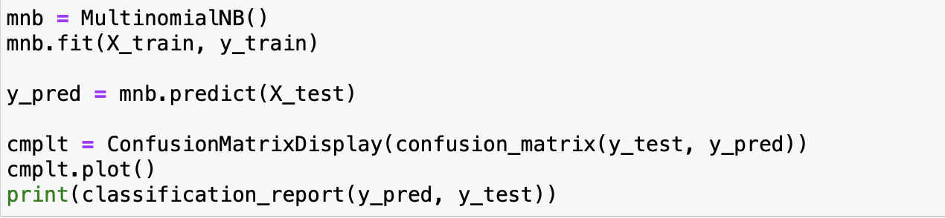
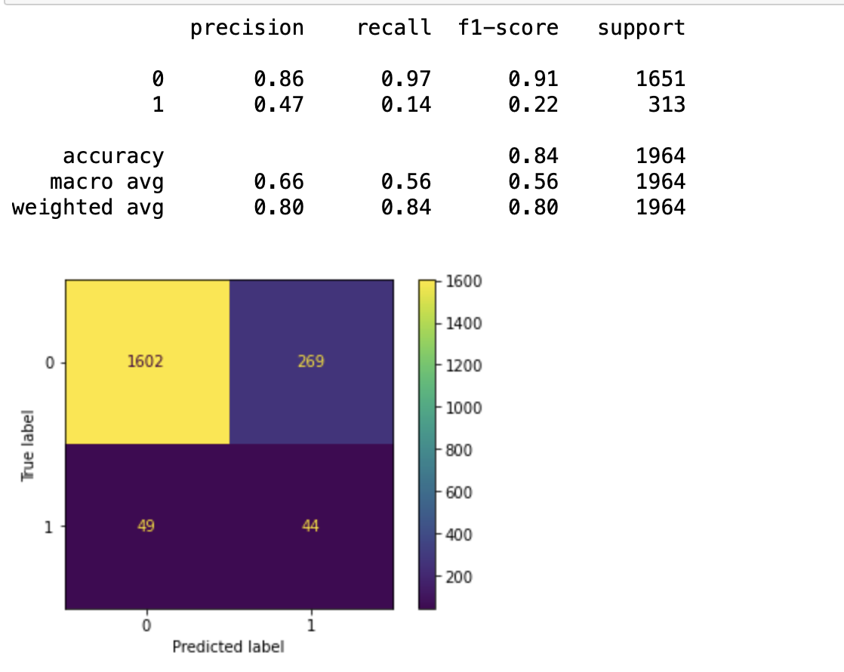
Multinomial Naïve Bayes
Model Accuracy is 84% with a Precision of 86% and Recall of 97%
When a patient is predicted to have a stroke it is correct 86% of the time.
The Multinomial Naïve Bayes classifier correctly identifies 97% of all stroke patients

Slide 13
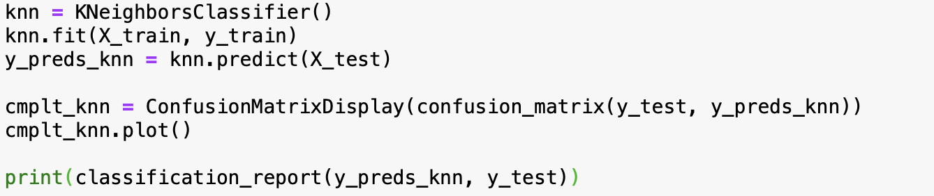
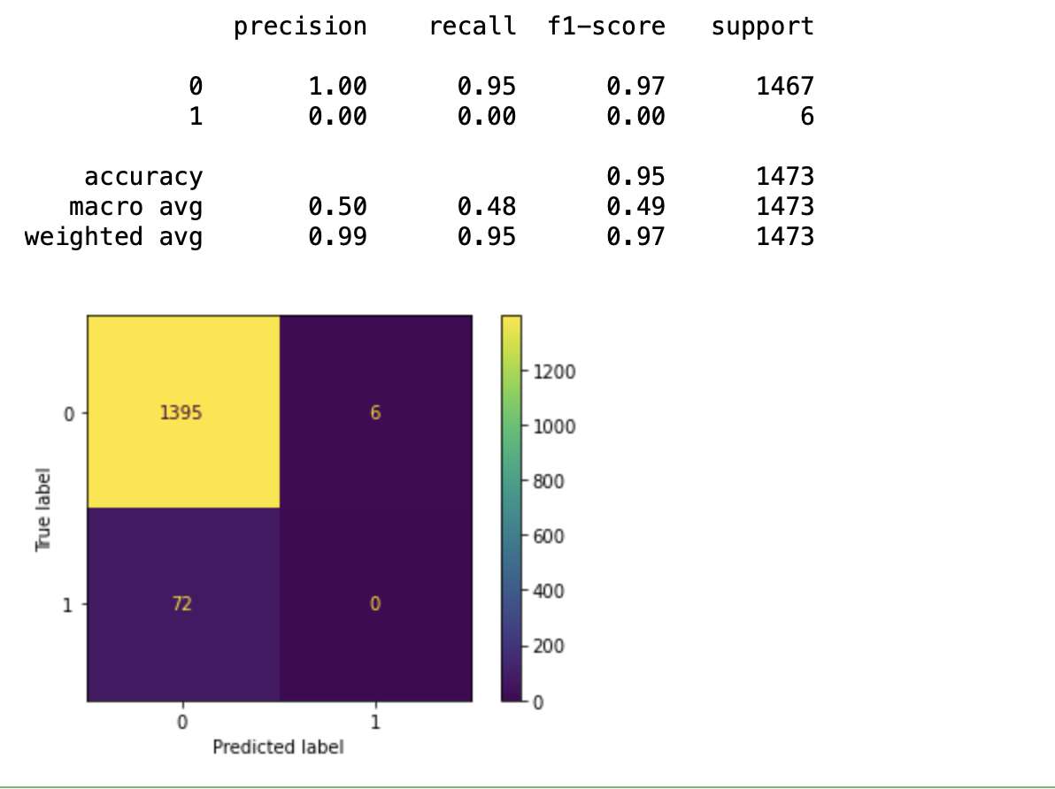
K-Nearest Neighbors
Model Accuracy is 95% with a Precision of 100% and Recall of 95%
When a patient is predicted to have a stroke it is correct 100% of the time.
The K-Nearest Neighbor classifier correctly identifies 95% of all stroke patients

Slide 14
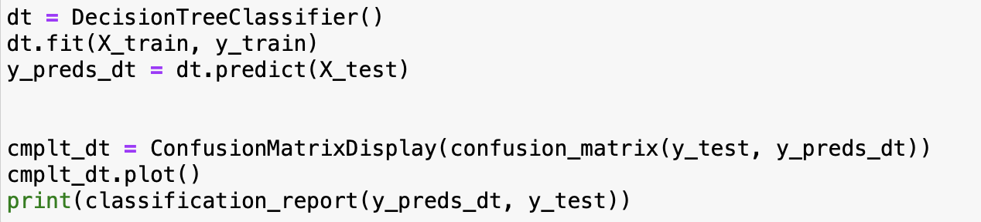
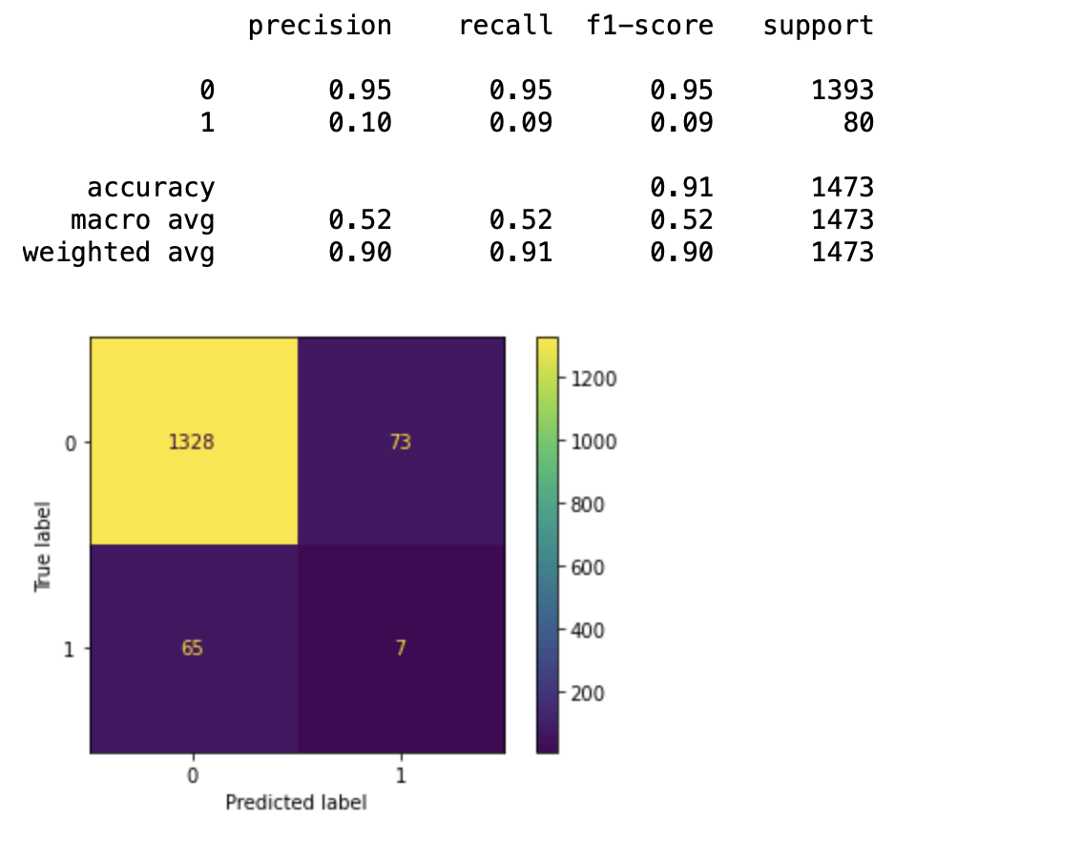
Decision Tree
Model Accuracy is 91% with a Precision of 95% and Recall of 95%
When a patient is predicted to have a stroke it is correct 95% of the time.
The Decision Tree classifier correctly identifies 95% of all stroke patients

Slide 15
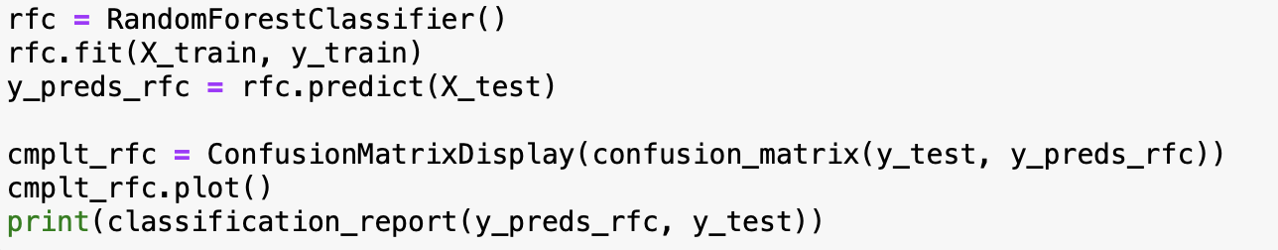
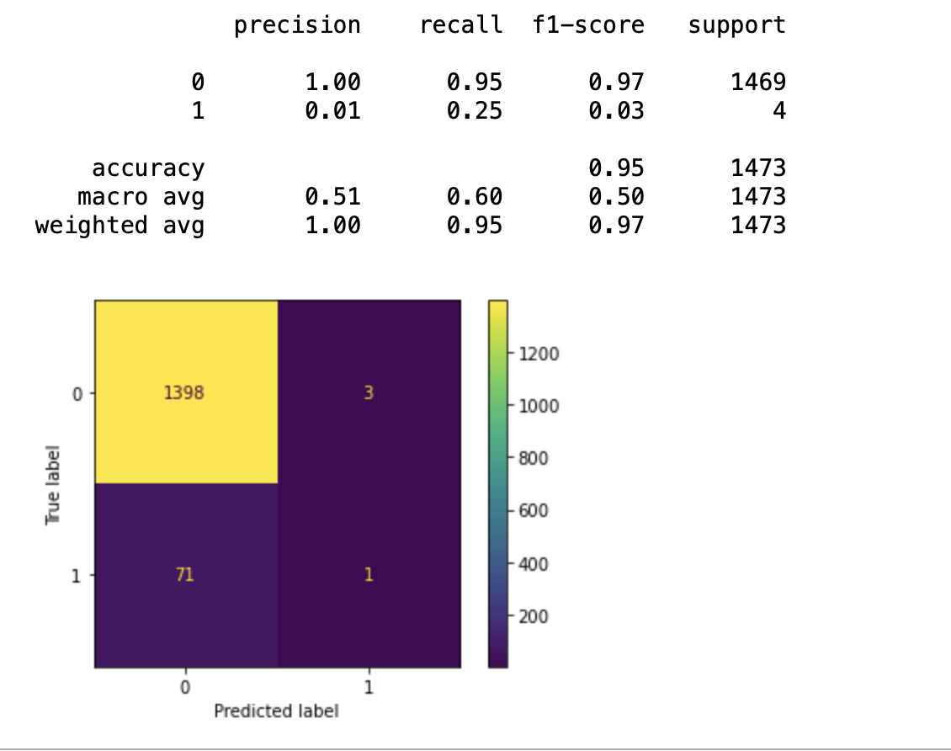
Random Forest
Model Accuracy is 95% with a Precision of 100% and Recall of 95%
When a patient is predicted to have a stroke it is correct 100% of the time.
The Random Forest classifier correctly identifies 95% of all stroke patients

Slide 16
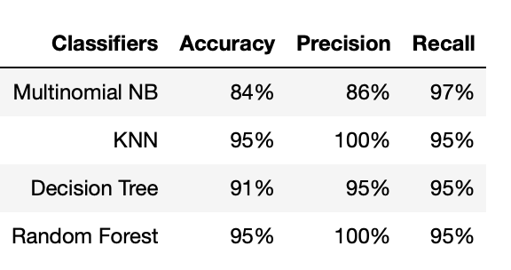
Final Results
K-Nearest Neighbors and Random Forest performed very well with an accuracy score of 95%. Decision tree followed with an accuracy score of 91% and Naïve Bayes performed the poorest out of the four classifiers with an accuracy of 84%.

Slide 17
Conclusion/Modifications
Overall, dataset was properly cleaned and prepared for model evaluation.
Conducted 4 supervised learning classifiers on dataset and computed 4 accuracy, precision and recall scores.
K-NN and Random Forest produced the higher accuracy scores. Random Forest would be the better one to choose as K-NN is very slow due to its computation time and RF handles overfitting much better.
If computation time is an important factor the Naïve Bayes followed by Decision Tree classifier are better options.

Slide 18
Future Works
Further analysis could explore why many patients that experienced a stroke did not have heart disease and whether heart disease is a reliable indicator of having a stroke.
The data gathered can be used by many to see what features are important to consider i.e. years of smoking, whether hypertension is present, etc. when dealing with a patient that could possibly have a stroke.
Data explored can be used by many hospitals or drug companies looking to tackle and help prevent others from having stroke. The EDA findings would allow them to draw conclusions as to who they should target for preventive measures i.e. gender, age, BMI, etc.

Slide 19
Thank You!

